Slide 1
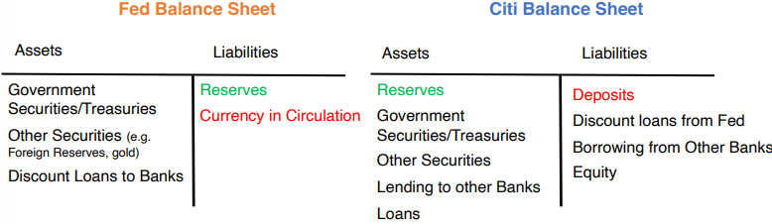
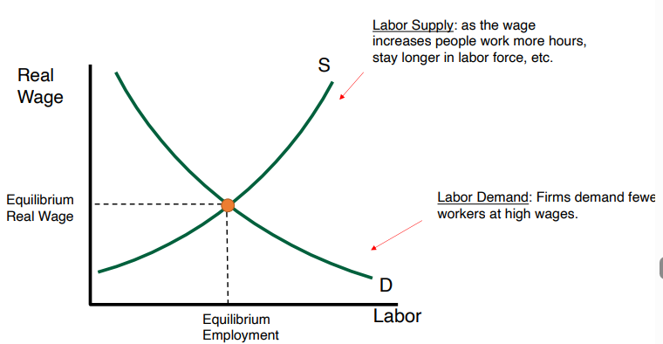
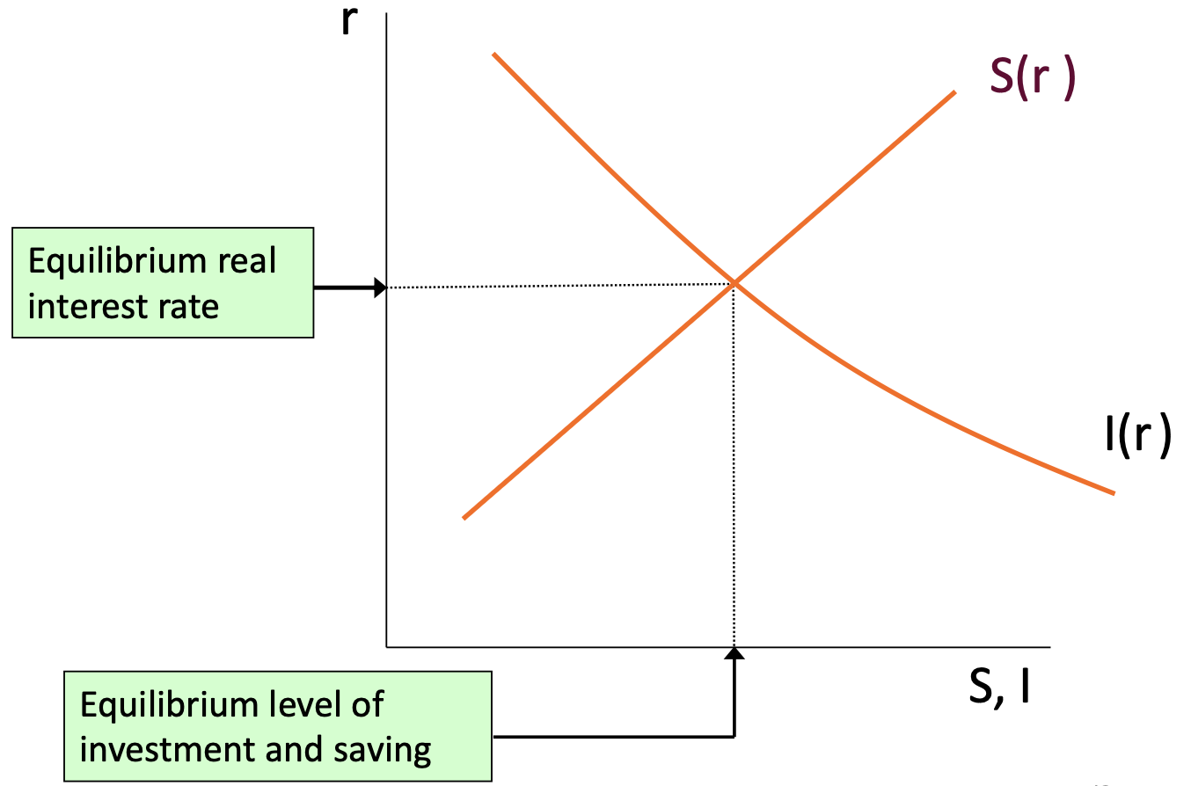
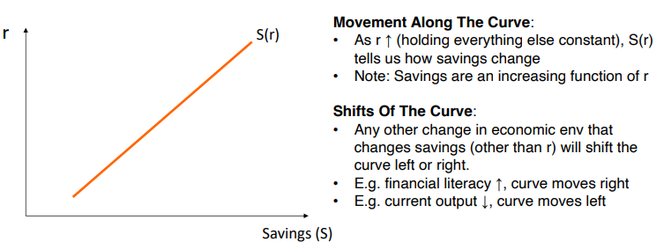
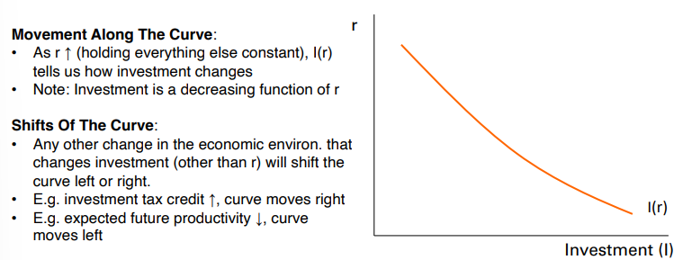
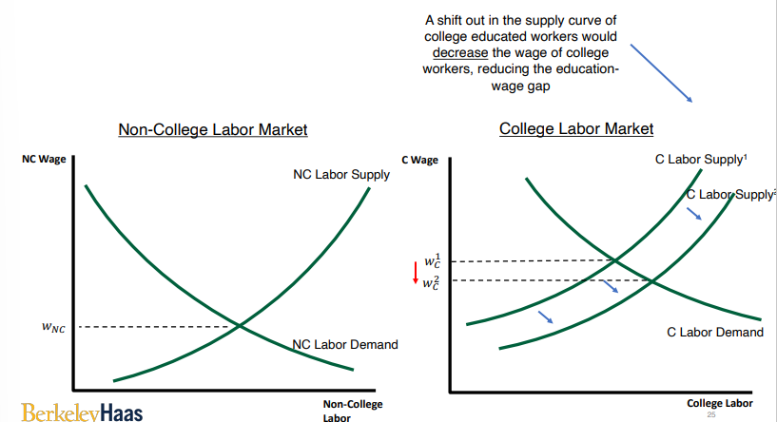
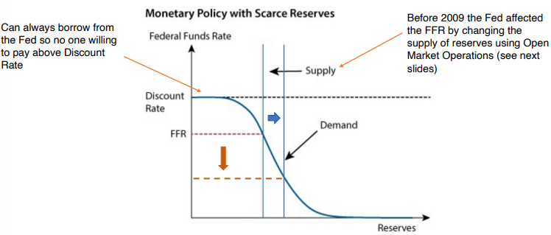
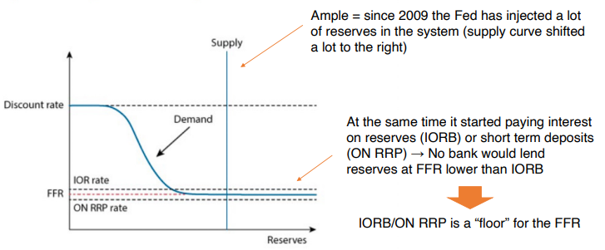
OVERVIEW OF GDP:
Only includes goods/services produced in that year, e.g. 2021 GDP does not include an old apartment bought in 2021 or cars produced in 2020 but sold in 2021; Market value of all final goods and services produced in the country in a given time period
To compare GDP from different years, use prices from base year:
•Real GDP₂₀₂₂ = P_{C,2012} Y_{C,2022} + P_{F,2012} Y_{F,2022}
•Real GDP₂₀₂₁ = P_{C,2012} Y_{C,2021} + P_{F,2012} Y_{F,2021}
Construct a GDP price index:
•𝑃₂₀₂₁= 𝑆h𝑎𝑟𝑒 𝑜𝑓 𝐸𝑥𝑝𝑒𝑛𝑑𝑖𝑡𝑢𝑟𝑒_{C,2021}× 𝑃_{C,2021} + 𝑆h𝑎𝑟𝑒 𝑜𝑓 𝐸𝑥𝑝𝑒𝑛𝑑𝑖𝑡𝑢𝑟𝑒_{F,2021}×𝑃_{F,2021}
• 𝑃₂₀₂₂= 𝑆h𝑎𝑟𝑒 𝑜𝑓 𝐸𝑥𝑝𝑒𝑛𝑑𝑖𝑡𝑢𝑟𝑒_{C,2022}× 𝑃_{C,2022} + 𝑆h𝑎𝑟𝑒 𝑜𝑓 𝐸𝑥𝑝𝑒𝑛𝑑𝑖𝑡𝑢𝑟𝑒_{F,2022}×𝑃_{F,2022}
Nominal GDP = Price Level x Real GDP
Growth_{Nominal GDP} = Growth_{Price Level (inflation)} + Growth_{Real GDP}
Real Interest Rate (r) = Nominal interest rate (i) – Inflation (π)
NATIONAL ACCOUNTS: Measuring GDP: i) Production: value of final goods and services produced within a country during a given time (discussed so far); ii) Expenditure: total spending on final goods and services
Y = C + I + G + NX → S - I = NX (S = Y-C-G)
Y = real output; C = real household consumptions; I = real investment adding to stock of physical capital; G = real gov spending; NX is real trade balance (exports – imports), = 0 for closed economy; S = savings
CPI – tends to overestimate inflation; PCE – tries to adjust for substitutes, does not overestimate. Both consumption-based (GDP Deflator -> production-based)
Core inflation excludes energy and food-related products, more subject to supply shocks. Inflation: all products Real wages = wages / price index. The change in real wages is the delta between the rate of change of the denominator and the rate of change of the numerator
Expected Inflation: Costs: “Menu” costs: waste of physical and mental resources to adapt frequent price change; “Shoeleather” costs: avoid holding any cash; Distortion in relative prices; Tax code is in nominal terms. Benefits: Avoid deflation
Unexpected Inflation: Costs: Hurts lenders (ex-post real interest rate is lower for a given nominal interest rate); Hurts pensioners (or anyone on fixed nominal income); Uncertainty reduces investment and consumption (high inflation often associated with variable inflation). Benefits: Helps borrowers; Reduces burden on governments paying pensions; Helps during imbalances in labor market if nominal wages do not adjust down
Deflation: fall in prices. Can lead people to postpone purchases (waiting for prices to lower further). Deflation also hurts debtors, leading to inefficient bankruptcies (Debt is denominated in nominal terms, deflation increases the real burden of debt)
Low and stable inflation is desirable: Not deflation; Makes labor markets more flexible (nominal wage cuts are rare; giving no raises is more common). Real wages (nominal wages/prices) can decline to equate labor demand and labor supply; Costs and redistribution are very small
Inflation: Favors borrowers (real value of loan decreases) / workers because income is variable / people with assets in less liquid forms (not cash, usually wealthier)
MONEY: any asset that can readily be used to make transactions
Money: store of value, medium of exchange, unit of account
C = currency in circulation; M1 = currency + demand deposits; M2 = M1 + retail money market mutual fund balances, savings deposit
Cryptocurrency: Digital Currency; Creation, transactions and holdings verified through a decentralized ledger based on blockchain technology (rather than a central authority)
Quantity Theory of Money: MV = PY where M = quantity of money; P =price level; Y = real output (GDP); V = velocity of Circulation (e.g. for paper bills, how often a bank note is used in transactions within a period)
𝜋 = 𝑔_{M} + 𝑔_{V} – 𝑔_{real Y} ~ 𝑔_{M} – 𝑔_{real Y}
Government Spending = Taxes + Debt + Seignorage
Hyperinflations are response to a failure to raise gvt revenues
Seignorage: When a gvt prints money to finance spending, aka “Inflation Tax”
Money creation: i) Currency in circulation: print more bank notes; ii) Deposit: created by the banking system. When banks make loans: a bank simultaneously issues a loan (asset)
• Limits to this “money creation”: (i) Loans must be profitable; (ii) Eventually expanding deposits/loans will lead banks to keep more reserve
CENTRAL BANKS:
Mandates: Price Stability (2% inflation) + full employment
CBs try to achieve their goals by altering credit conditions
• Making it less expensive to borrow stimulates borrowing → increased investment and consumption → growth of output, employment and prices
• Making it more expensive to borrow reduces borrowing → lower investment and consumption → slower growth of output, employment and prices
• Examples: If inflation is high, central banks tighten credit conditions and make it more expensive to borrow // If inflation is low, central banks loosen credit conditions and make it cheaper to borrow // If inflation is high and output is low, CBs with a dual mandate must prioritize their goals (i.e. no easy answer)
• Reserves: “Deposits” banks hold with the central bank
• Some central banks pay interest on excess reserves (reserves above the required amount) e.g. IORB by Fed • Bank wants to hold reserves to settle transactions with other banks
HOW CBs CONTROL FFR:
Fed doesn’t actual fix the FFR -> Sets target range (e.g. 3-3.25%), then uses levers (OMO, interest on reserves etc) until it reaches target
Reserves impact Fed funds – opposite untrue. FED does not directly determine the target, it determines the amount of reserves (that indirectly impacts the federal fund rate)
Open Market Purchase (expansion & ↓ FFR)
• Step 1: Fed buys treasuries from banks to inject reserves into the economy (expansionary monetary policy), bank reserves increase
• Step 2: Banks adjust to excess reserves: lend reserves to other banks (reserves ↑, thus FFR ↓), increase lending, buy other securities (Price of securities ↑, yield sec.↓). Borrowing becomes cheaper (abundant loans), will increase inflation (expansionary policy)
Open Market Sale (cool economy & ↑FFR)
• Step 1: Fed sell treasuries to banks, bank reserves decrease
• Step 2: Banks adjust to lower reserves by making fewer loans, increasing interest rates
Quantitative Easing: Used when the FFR hits zero; CB purchases longer-term securities, including non-government securities, to lower long-term interest rates & encourage lending/investment
GROWTH:
Solow Model: Investment -> Capital Stock ↑
𝑌 = 𝐴 𝐹(𝐾, 𝐿) = A Kª L^{1-a} -> gy = gA + a gk
gA = total factor productivity (TFP); gk = capital per capita growth
Marginal Product of Capital: ↑Output from Adding One Unit of K
Marginal Product of Labor: ↑ Output from Adding One Unit of L
Diminishing Marginal Returns: ΔOutput from a 1%↑ in capital stock (per worker) lower at high levels of capital (less bang)
TFP varies by country based on misallocation of K&L, innovation, and policies/regulation
Misallocation measured by variance of return to capital (i.e not equitable access to funds)
Strong link: quality of institutions and GDP per capita
LABOR MARKETS:
More demand for workers leads to higher wages
Reduced costs for workers leads to higher employment
POP = NILF + E + U; LF = E + U; LF Participation Rate = LF / POP; Employment Population Ratio = E / POP; Unemployment Rate = U / LF
LF
Unemployment Rate = Natural Rate + Cyclical Rate
Natural Rate: The long-run, steady unemployment rate around which the economy fluctuates
Cyclical Rate: Linked to booms and recessions
[Unemployment] Natural = Frictional + Structural
Frictional = takes some time to find new job due to different abilities, preferences, geography, imperfect flow of info
Structural = persistent due to rigidities like minimum wages, regulations, unions, unemployment benefits, migration/retraining costs
s*E = f*U → steady-state U/LF = s/(s+f)
f = rate of job finding, the fraction of unemployed workers who become employed in any time period (exogenous)
s = separation rate, the fraction of employed workers who become unemployed in any time period
Rigidities:
Min. Wage: Above equil. real wage: real wage ↑ and employment ↓. Non-competitive market: unemp. ↑ or ↓
Excess mkt regulations, unions, unemp. Benefits, migration/training costs, mismatch skills and tasks, higher wages to incentivize effort
Monopsonist: Can employ a less workers and lower the wage (this is profitable)
Inequalities:
Rising wage inequality in the US -> increased returns to education, polarization of structure (very high and very low). Tech. Change + Automation, Trade and Offshoring
MISC OBSERVATIONS FIRST HALF:
CB decrease inflation policies (contractionary): Increase the interest rate paid on excess reserves to commercial banks; Sell government bonds to commercial banks; Increase the reserve requirements for commercial banks
QE Policy: purchasing a lot of government securities; sale of very liquid assets to commercial banks and the purchase of very illiquid assets such as MBS
Structural Unemp.: If unions help firms cut wages during recessions, ↓ structural unemployment. Frictions that prevent workers and firms from immediately forming new matches contribute to frictional unemployment
Example Gvt Policy: New policy that helps train lower paid to become higher paid workers -> Increase the supply of high paid workers, lowering wages, while decreasing the supply of lower paid workers, increasing wages -> smaller differential
GDP Deflator: Nominal GDP / Real GDP
BUSINESS CYCLES:
Recession: period between peak and trough. Expansion: period between trough and peak. Recessions can be very short (e.g., Covid recession was 2 months)
Not only about aggregate output: co-movements in output, employment, consumption, investment, unemployment. Aggregate phenomenon
Output gap = (𝑌 − 𝑌𝑝)/𝑌𝑝 (important and difficult to measure whether ↑ GDP are due to ↑ potential output short-run fluctuations)
Recession:↑unemployment,↓consumption, ↓
Yield curve: Typically upward sloping (long-term rates > short-term due to risk premium/uncertainty); inverted yield curve can predict recessions markets may expect Fed having to lower rates), but not always
Long-run: Prices/wages fully flexible and respond to changes in supply and demand; output is determined by supply side (factors of production & tech)
Short-run: Prices/wages are sticky and adjust gradually; output depends on demand (C, I, G, EX, etc) -> some factors of production idle -> unemployment, low capacity utilization
Low r: Low S & high I
High r: High S & low I
Slowing economy shifts I left, while aging populations shift S right, causing ↓r
Ample reserves

Slide 2
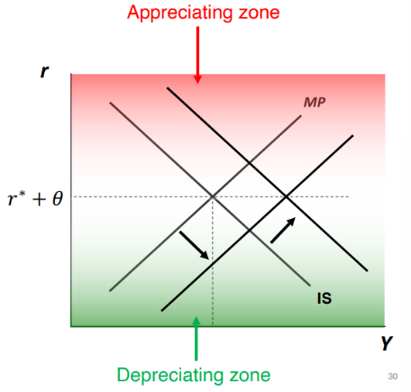
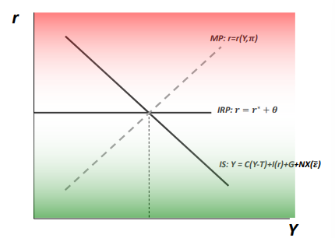

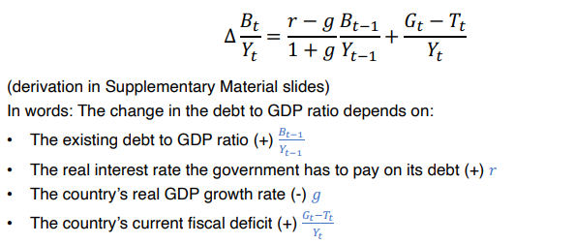
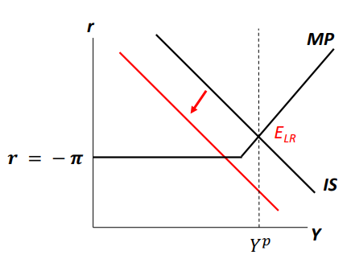
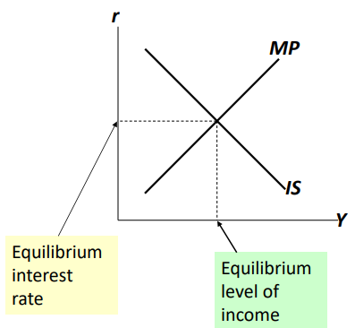
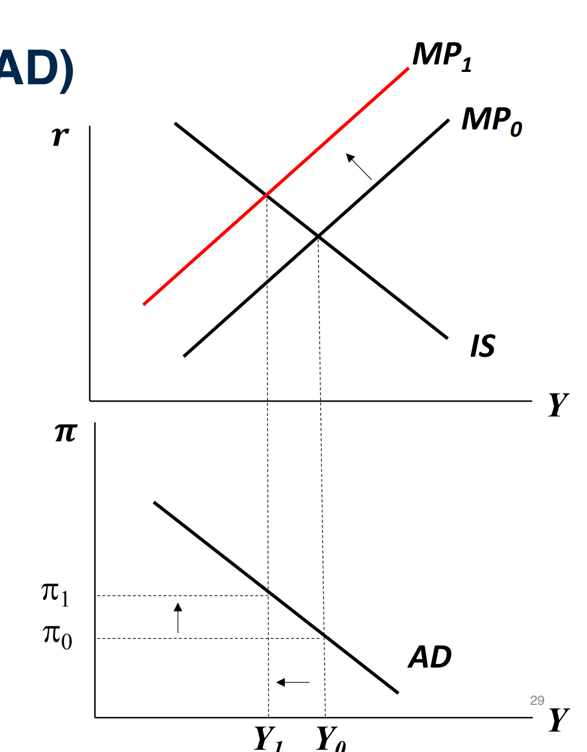
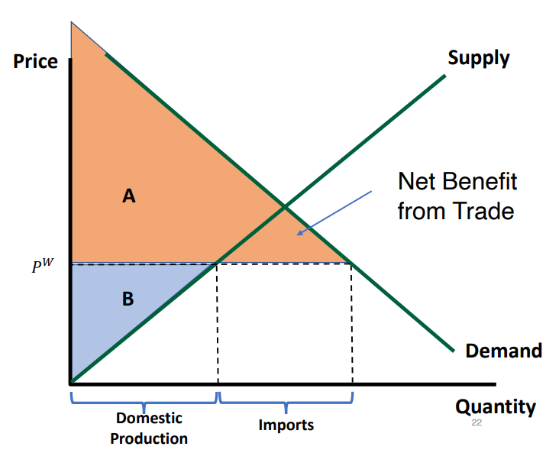
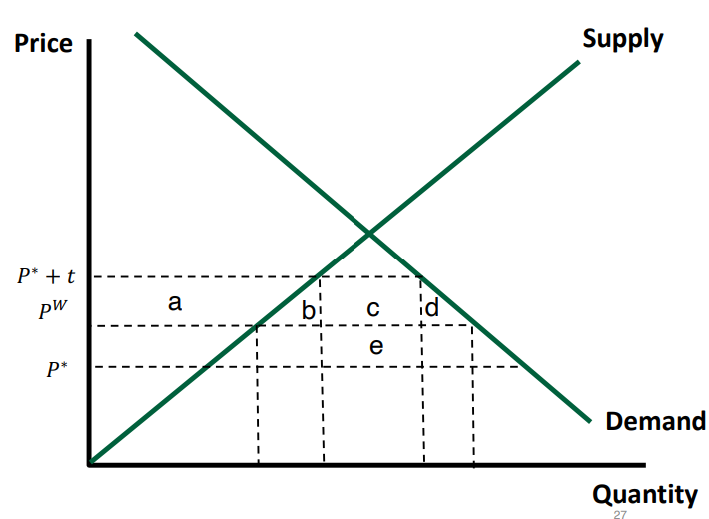
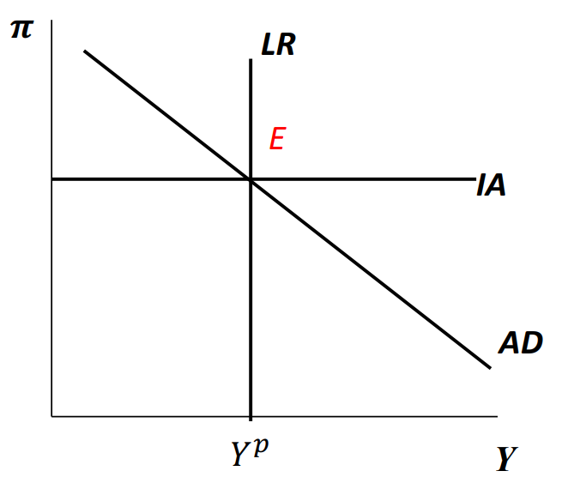
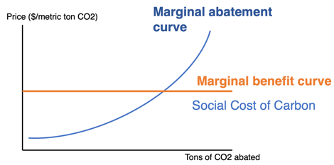
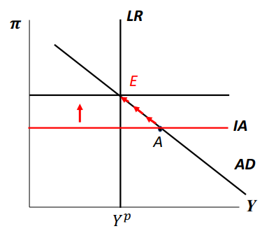
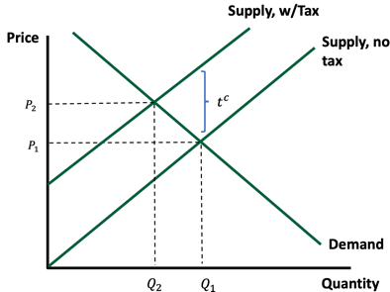
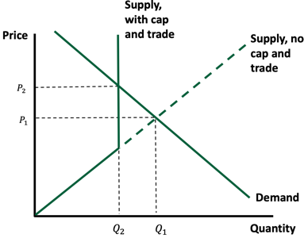



Marginal propensity to consume (MPC): Extra consumption for each extra dollar of disposable income
𝑌=𝐶(𝑌−𝑇) + 𝐼(𝑟) + 𝐺
𝐶(𝑌−𝑇): Consumption as function of disposable income
Y-T = disposable income (income – taxes)
I(r) = investment is decreasing function of r
Goods market in short run – Step 1: holding r constant
↑ income -> ↑ consumption (positive loop)
𝐶(𝑌 − 𝑇) = 𝑀𝑃𝐶×(𝑌 − 𝑇)
Fiscal multiplier: ΔY/ ΔG > 1 means that recipients of extra income spend part of it to generate additional income; size of fiscal multiplier depends on MPC
If the government increases expenditure G by building new bridges, output Y increases by more than G
Large: Spent on infrastructure -> Large MPC -> large multiplier
Small: Spent on government consumption (wages)
Fixed exchange rate > closed economy > flexible exchange rate
Goods market in short run – Step 2: IS Curve: vary the real interest rate r → IS curve. I(r) ↓ when r ↑: intuition: as r ↑, investment ↓ -> ↓ aggregate expenditure, ↓ output
Shifters: General rule: IS curve shifts to the right if output expands, holding the real interest rate r fixed (Government expenditures, taxes, productivity, future income (expectations), consumer confidence)
MP Curve: r = r (Y, π)
Slopes up because Central Banks tend to increase interest rate when economy grows
Shifts up when inflation increases (higher interest rate, holding output Y fixed)
IS-MP MODEL EQUILIBRIUM:
Consequence of ↑ G: Interest rates ↑, because Fed will respond to increase in output B. Investment ↓
Does G crowd out private investment? If lots of liquidity + interest rates are low → NO (Fiscal multiplier is large); When interest rates rise in response to government debt → YES (Fiscal multiplier is small). E.g., recent study shows French municipalities that expand debt “crowd out” investment because of limited local credit supply
AGGREGATE DEMAND (AD) & AD-IA-LR DIAGRAM:
Examples:
↓ consumer confidence: IS & AD shift left. Fearing ↓ π, CB ↓r by shifting MP right. In EQ, Y is same, while π & r are lower.
↓ taxes or ↑G (opposite of ↓ consumer confidence): Shift IS and AD to right. Fearing ↑π, CB ↑r, which shifts MP and AD curve to left. In EQ, Y is same, while π and r are higher.
Tech ↑ productivity: LR shifts right; AD intersects new LR at higher Y and lower π. Fearing ↓π, CB ↓r , which shifts MP and AD to right. In long run, Y is higher, r is lower, and π is same.
↑Prices: Fearing ↑π, CB ↑r, which shifts MP and AD to the left, causing a recession.
This caused further inflation -> Volcker ↑ FFR to ~ 20%
Shift AD curve:
Same direction as IS. Left with ↑r/π. Right with ↓r/π
Shift LR curve:
Left with pandemic slowdown
Right with economy-wide technological revolution
2008 Financial Crisis: Dramatic consumption drop. If the economy is initially at potential output, what happens in both the AD-IA-LR diagram and the IS-MP diagram? The AD curve and the IS curve both shift down
Lower other longer term interest rates with Quantitative Easing D
Gvt spending to move the IS back up
Gvt fiscal intervention, 3 pillars: stimulus, bailout for companies, recovery and reinvestment act.
OPEN MARKETS / EXCHANGE RATES
• ε = eP/P* where ε = real exchange rate (number WITHOUT units); e = nominal exchange rate; P = price of a domestic basket of goods; P* = price of a foreign basket of goods; * = foreign
• Example: 1 Mexican Peso = 0.05 USD so e = 0.05
Exchange Rate Regimes: many countries -> hybrid system
• Fixed (pegged) Exchange Rate: CB buys/sells foreign assets to keep value of currency fixed; value of exchange rate not market determined; CBG constantly intervenes on forex market; monetary policy ineffective. ↑: Revaluation; ↓: Devaluation
• Flexible (floating) Exchange Rate: Value of currency determined by market forces on forex market, without CB intervention, nominal exchange rate fluctuates, fiscal policy ineffective. ↑: Appreciation; ↓: Depreciation
Purchasing Power Parity (PPP): Law of One Price should hold: identical goods should sell at the same price everywhere. If countries consumer similar goods, then ε = 1. If ε < 1, currency is undervalued. Ex: Most currencies are undervalued against USD, so probably USD is overvalued.
• Monetary Policy Effective: in a) closed economy relative to open economy w/ fixed rates and b) in open economy with flexible relative to open economy with fixed rates (Mundell-Fleming Model)
• Ex: ↓G will ↓Y in a) closed economy relative to open with flexible rates and b) open economy with fixed rates relative to open economy with flexible rates
• 𝜃 = risk premium required by lenders for small economies
• If 𝑟 > 𝑟∗ + 𝜃 the domestic currency appreciates → 𝜀↑
• Intuition: Foreign lenders will look to buy domestic assets and will increase demand for domestic currency, causing appreciation
• If 𝑟 < 𝑟∗ + 𝜃 the domestic currency depreciates → 𝜀 ↓
• Ex: Panama’s currency linked to USD. If US has recession and ↓r*, this makes the USD less attractive than Balboa. CB of Panama ↓ r to maintain exchange rate stability and Panama experiences expansion
• Ex: To control rapid expansion, CB of US ↑r* to↓π. As r* ↑, the USD becomes more attractive. To keep exchange rate stability, CB of Qatar must ↑r, causing I↓ and recession.
Trade balance and real exchange rate:
Assume trade balance depends only on real exchange rate
Assume NX(ε) ↓ when ε ↑
Intuition: when real exchange rate higher, domestic goods are more expensive relative to foreign goods
Exports ↓, Imports ↑ -> Exports – Imports ↓
IS-MP Model under flexible/fixed exchange rates:
IS Curve:
MP Curve (flexible):
Interest Rate Parity Rule (flexible):
IR Parity (fixed):
MP (fixed): Redundant: ∆ ε = 0 by definition
Problem Currency Depreciation: imports ↑ expensive; ↓ foreign investments (capital goes back); ↑ cost of debt;
DEBT SUSTAINABILITY:
Definitions: Budget Balance = Tax Revenues (T) – Government Spending (G) > 0 : Budget Surplus < 0 : Budget Deficit; Government spending = interest on stock of debt + current spending (all spending that is not interest); Primary surplus or deficit = tax revenues – current spending; Deficit is a flow measure. Typically reported as Deficit/GDP; Debt is a stock measure (accumulated deficits), typically reported as Debt / GDP
Good for debt sustainability: ↓ corruption, ↓G, ↑taxes, ↑ services (education, infrastructure), ↓ printing money
Bad for debt sustainability: ↑r, ↑ aging of population, ↑healthcare costs, ↑G, ↓taxes, ↑printing money
Unclear for debt sustainability: AR fixing peso to USD could be good if stability of peso ↓π and ↑ growth, but bad if other currencies depreciate and AR loses competitiveness in world market
INTERNATIONAL TRADE / TRADE BALANCE / TARIFFS:
NX = X – IM, where X = value of exports and IM = imports
Some facts: countries that run large trade deficits borrow from the rest of the world, trade agreements barely affect a nation’s trade balance, trade deficits are determined primarily by a nation’s savings and investment imbalance
Consumer surplus (A): Measure of consumer welfare, i.e. gap btwn what consumers were willing to pay and the price actually paid
Producer surplus (B): Measure of producer welfare = gap btwn price firms were willing to sell and price they received
Consequences of tariffs:
Consumers lose a+b+c+d, since they now face a higher price of p^{w} + t
Producers gain a, since they face less competition in the domestic market (↑ price foreign competitors)
Tariff revenues is c
Society loses b+d (“deadweight loss”), paid by consumers
If p^{w} is affected by the tariff such that p^{w} > p* (e.g. occurs when US is large consumer of foreign product and tariff causes ↓ demand)
Tariff revenue = c+e and Δ Welfare = - (b+d) + e
When to do tariffs? Bad if imposed by a small country. Good if imposed by a large country and it lowers the price that exporters receive (p^{w} > p*) to increase welfare
Trade War – tariff burden entirely shouldered by US consumers & firms that use Chinese inputs
ENVIRONMENTAL SUSTAINABILITY:
The Social Cost of Carbon (SCC) is the monetized net present value of the damages arising from emitting 1 extra (metric) ton of CO2 in a given year. Damage : mortality, morbidity, crop failures, destruction of capital, productivity, energy use
Carbon tax - sets the price of carbon emissions and allows the market to determine the quantity of emissions reductions
Cap-and-trade sets the quantity of emissions (corresponding with quantity produced Q2) and lets the market determine the price through an exchange where firms can trade permits to emit carbon.
Tax: More predictability for firms (in terms of costs) and governments (in terms of revenues); Simpler and less costly to implement; More broad-based – all sectors can pay it. Cap-and-trade is infeasible for some sectors (e.g. transportation, residential heating/cooling)
Cap and Trade: Not a tax! Politically easier to implement; Guaranteed reduction of emissions – under Carbon tax depends on demand
xxx:
xxx
xxx
•xxx
xxx
•xxx
•xxx
MP Expansion: Flexible
MP Expansion: Fixed
Fed hits the zero lower bound
How to get out of the current situation with FFR at zero and output falling?
Affect expectations of future inflation to lower the real interest rate C
Short-run: combination of r and Y that simultaneously satisfies the equilibrium condition in the goods markets and is consistent with the conduct of monetary policy: IS: C(Y – T) + I (r) + G and MP: r = r (Y, π)
Aggregate Demand (AD) curve: combinations of Y and π where output market is in equilibrium and consistent with CB policy
AD-IA-LR Diagram:
LR (Long Run): potential output This is steady-state output from our growth model
At point E: output is at potential and inflation is constant
IA (Inflation Adjustment) line marks the current level of inflation
How does inflation adjust when output is not at potential?:
IA curve shifts up or down depending on whether output is above or below potential:
If Y < Yp, then π ↓
If Y > Yp, then π ↑
Example: imagine the economy finds itself at point A. Output above potential, thus inflation increases and IA shifts up till it reaches E
Application: 1970’s Oil Shocks and Volcker Tightening
1. Oil shocks of 1974 and 1979: OPEC raised oil prices
2. Vietnam/poverty had increased spending
3. Productivity ↓, but policy makers thought it was a temp recession: monetary policy was kept loose (low interest rates)
This caused further inflation
Thus, Paul Volcker raised FFR to close to 20%
Abate up to point where marginal cost of additional abatement = marginal benefit of avoiding 1 ton CO2 (aka social cost of carbon)
Expensive stuff (carbon capture & storage)
Inexpensive stuff (LED lights)
Example
Carbon Tax
Cap and Trade

